Slide 1



Project Title : Water Quality Prediction using Machine Learning and Deep Learning Approaches
1
Group No : 06
Submitted By,
Name : Suria Sarmin Tripty ID:20210204005
Name: Masudur Rahman Saki ID:20210204009
Name : Meherin Khan Mili ID: 20210204020

Slide 2


Table of Contents
01
02
Dataset Analysis
03
Methodology
Introduction
04
Model’s performance
05
Result Analysis
06
Conclusion & Future work
2

Slide 3
Introduction
3
Access to clean drinking water remains a critical global challenge.Our model addresses this by using deep learning to automatically predict water potability from basic quality parameters.This is a CNN-based deep learning framework for water quality prediction. By analyzing parameters like pH and turbidity, our model achieves high accuracy in classifying water potability, offering an efficient AI-powered solution for environmental monitoring.

Slide 4
DataSet
4
3,276 Water Sample records
Features: 9
PH : acidity or alkalinity of water
Hardness : calcium and magnesium content
Solids (TDS) : dissolved solids present water
Chloramines : Disinfectant level
Sulfate : Concentration of sulfate compounds
Conductivity : Ability conduct electricity
Organic Carbon : Amount of organic compounds
Trihalomethane : By-products formed during chlorination
Turbidity : water clarity and suspended particles
Potability Target Level 0 (potable ; Safe)
1 (non-potable ; unsafe)

Slide 5
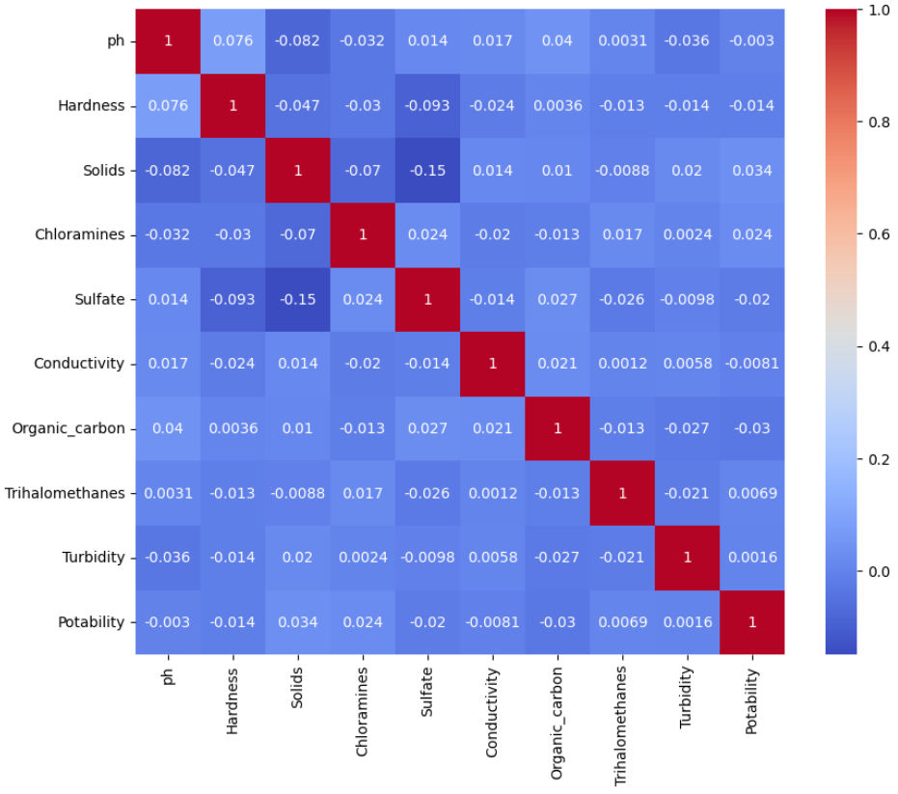
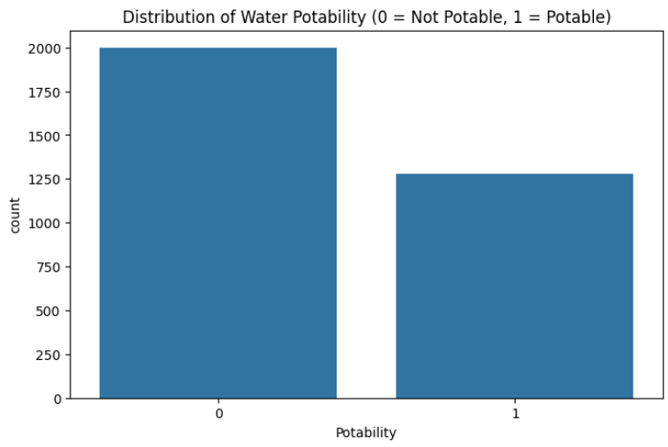
Analysis of Water quality parameters
5
Correlation Matrix of Water Quality Features
Class Distribution of Water Potability

Slide 6
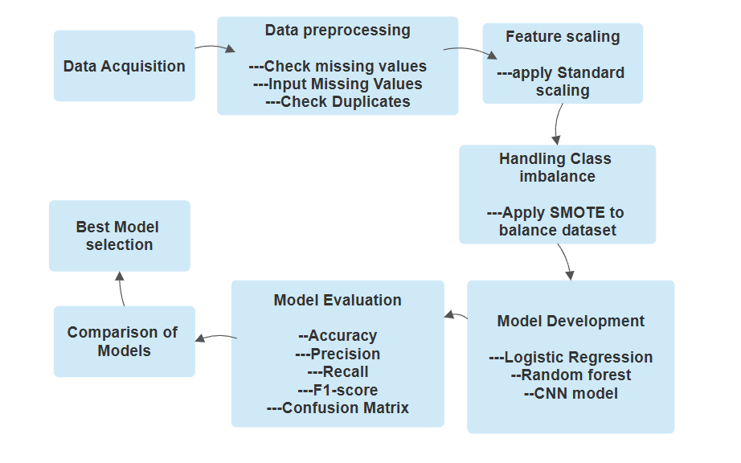
Methodology
6

Slide 7
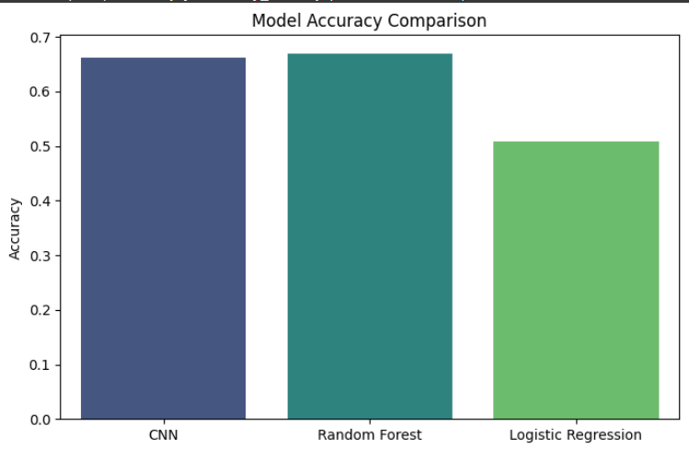
Model’s performance
7
Model | Accuracy | Precision | Recall | F1-Score
CNN | 66.14% | 0.6983 | 0.5652 | 0.6248
Random Forest | 66.97% | 0.685 | 0.6254 | 0.6538
Logistic Regression | 50.79% | 0.507 | 0.4849 | 0.4957

Slide 8



Result Analysis
CNN
Random forest
Logistic regression
8
moderate accuracy but lower Recall
Decent Performance despite Recall Limitation
Consistence among metrices(Strong Recall,highest Accuracy,good F1-score)
Robustness for classfication task
Poor performance(lowest accuracy, poor score in all metrices)
Insufficient For capturing Complex water Patterns

Slide 9




Conclusion:
9
Future Work:
We successfully developed an AI model that can effectively predict water potability.The Random Forest model proved to be the most balanced and reliable for this task. This project demonstrates that AI can be a powerful tool for automated water quality monitoring.
01
Add time analysis to track how water quality changes
02
Include weather and location data for better predictions:
03
Add more water quality factors (Lead, Bacteria etc)

Slide 10
Thank You
10

